Slide 1
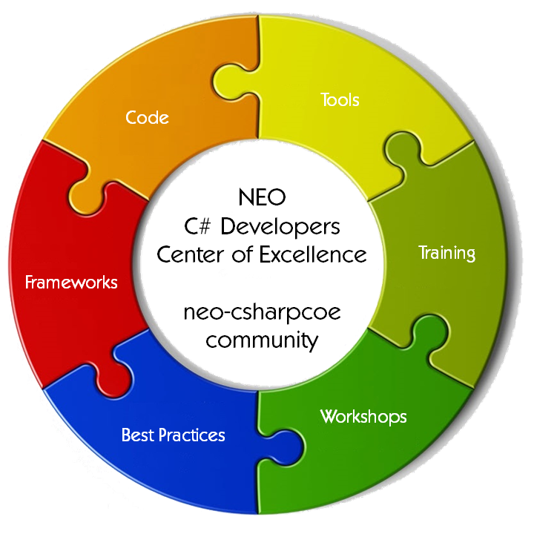
NEO Persistable Classes 2.1 Platform for Python Smart Contacts
Michael Herman and Nate Bronstein
Independent Blockchain Developers
NEO C# Developers Center of Excellence
https://github.com/mwherman2000/neo-csharpcoe

Slide 2

Sponsored by
Tools
Code
NEO
C# Developers
Center of Excellence
neo-csharpcoe
community
Training
Frameworks
Workshops
Best Practices

Slide 3
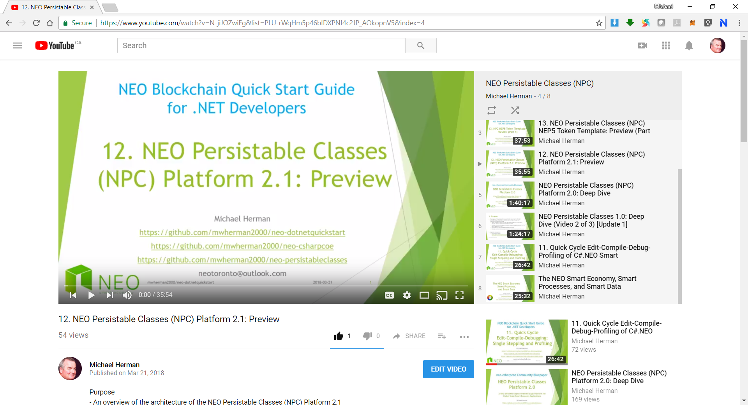
Homework
Watch the webcast “12. NEO Persistable Classes (NPC) Platform 2.1: Preview” https://www.youtube.com/watch?v=N-jiJOZwiFg

Slide 4
Preparation / Roadmap NATE: First 9 step are complete
Install Visual Studio 2017 Community Edition (free) TODO
Modify the Visual Studio 2017 configuration to include Python support TODO
Follow the normal NPC process to create a Model Class project using C# TODO e.g. NPC.mwherman2000.NEP5Token.Model
Configure the NPC Compiler (npcc.exe) to be the “debugger” for the Model Class project TODO
Create a (C#) NEO Smart Contract project for the C# version of the smart contract TODO e.g. NPC.mwherman2000.NEP5Token.Contract
Click Start to run the NPC Compiler to generate the NPC C# support files in the C# smart contract project
Manually include the generated C# support files into the Visual Studio project
Create a Python Model project for the manually-created Python version of the C# smart contract (from Step 5-6-7) e.g. NPC.mwherman2000.NEP5Token.ManualPContract
Create a second Python Model project for the automatically generated Python version of smart contract e.g. NPC.mwherman2000.NEP5Token.PContract
Manually translate/port the C# from NPC.mwherman2000.NEP5Token.Contract to NPC.mwherman2000.NEP5Token.ManualPContract

Slide 5
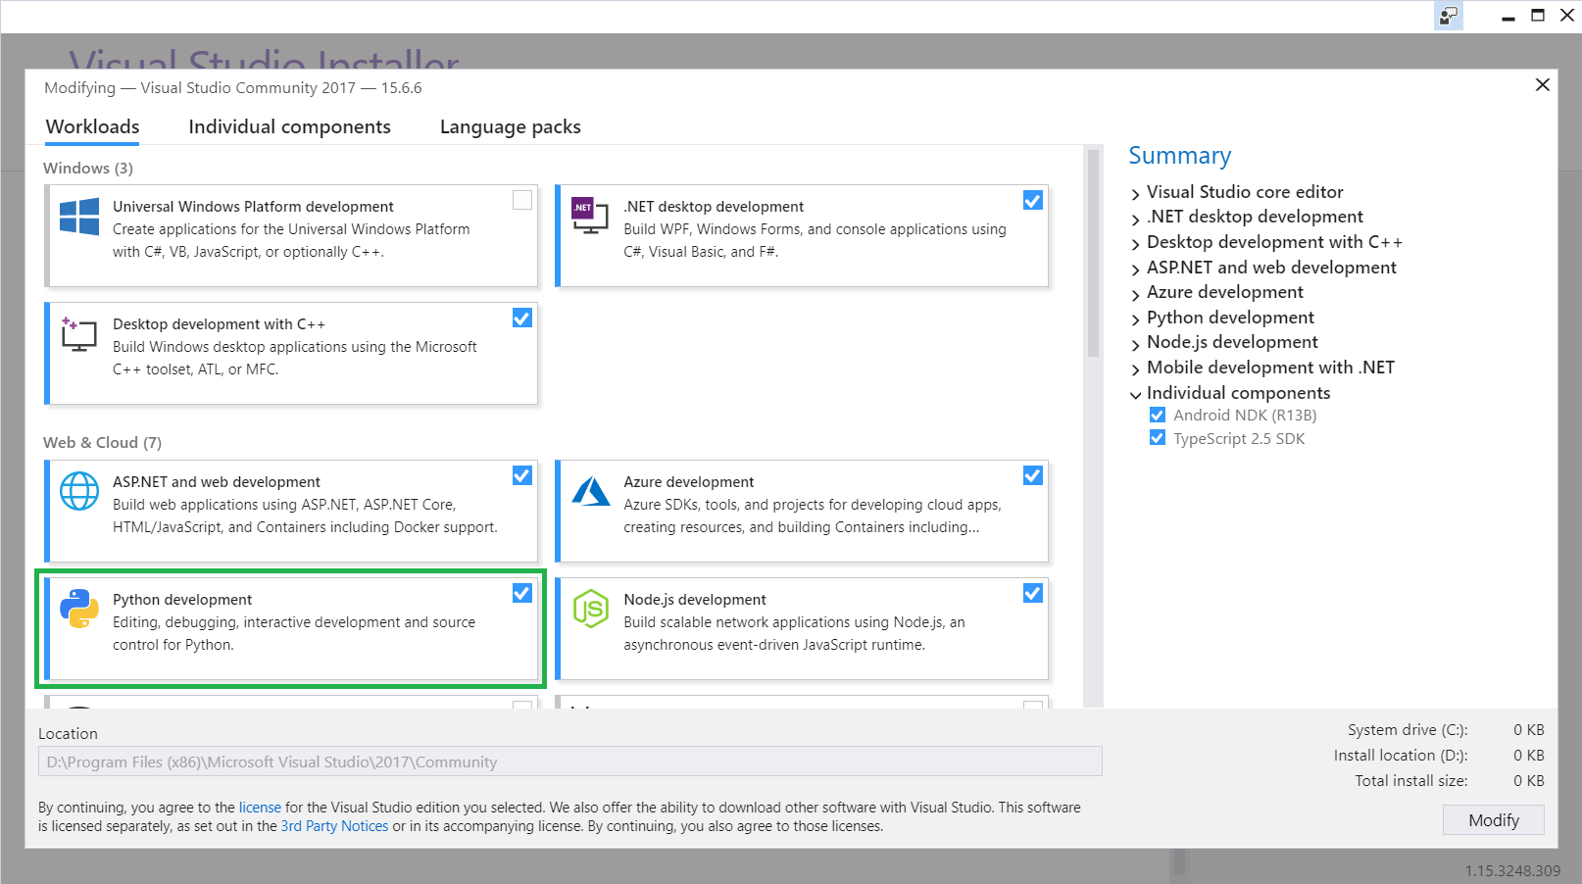
2. Modify the Visual Studio 2017 configuration to include Python support

Slide 6
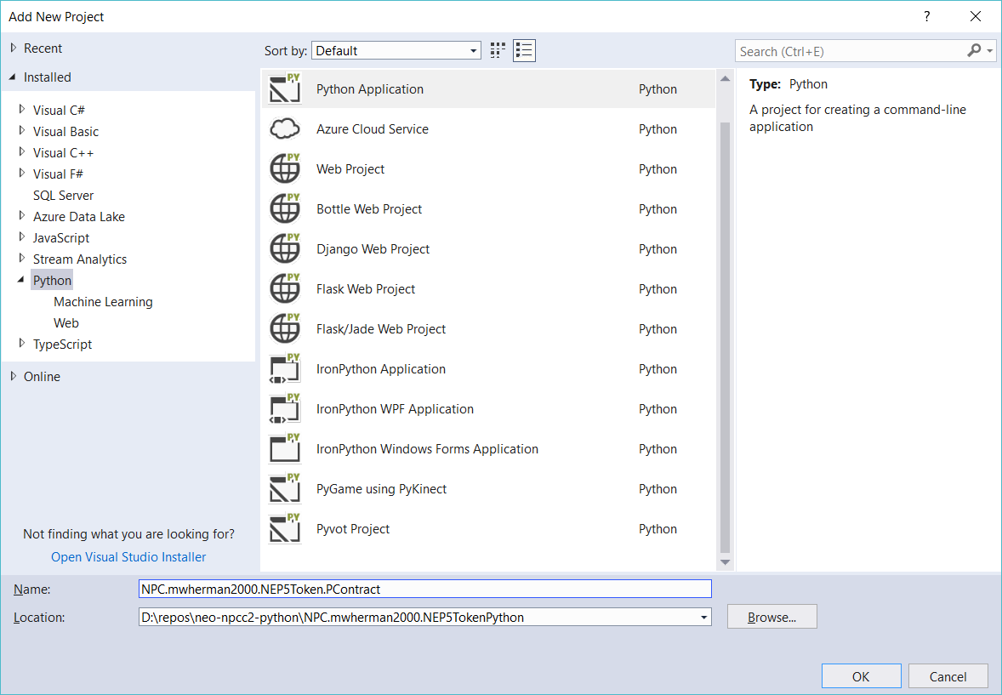
8,9. Create a Python Model projects NPC.mwherman2000.NEP5Token.ManualPContract NPC.mwherman2000.NEP5Token.PContract

Slide 7
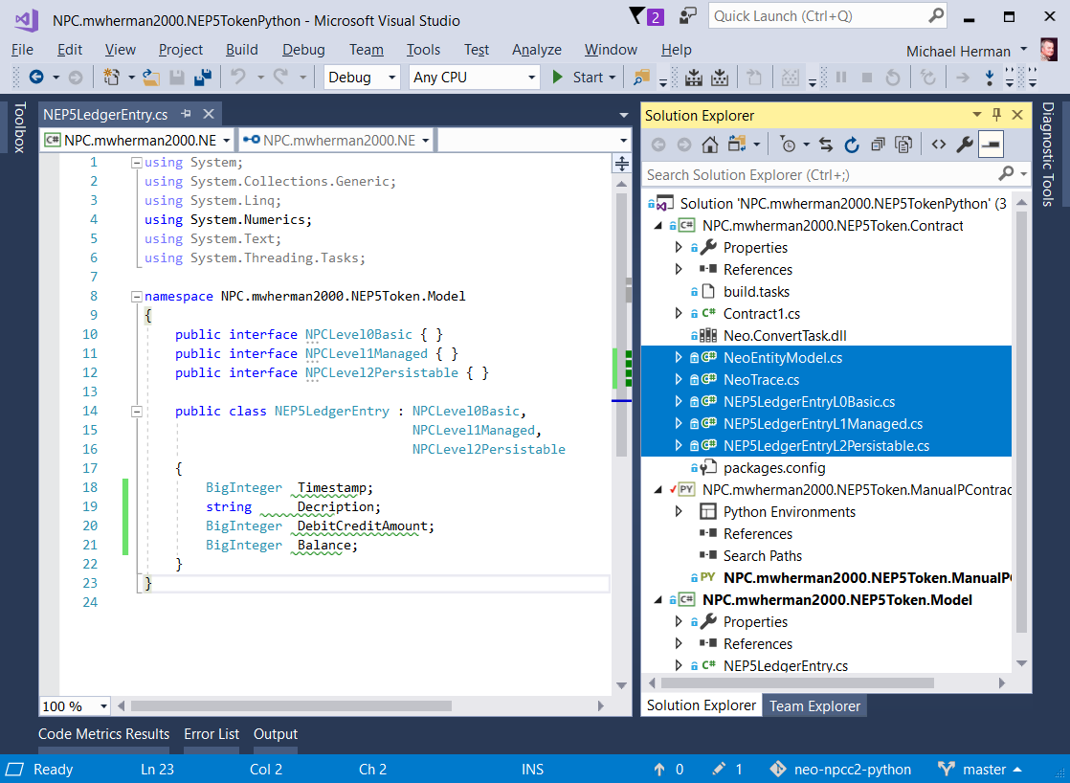
10. Manually translate/port the C# from NPC.mwherman2000.NEP5Token.Contract to NPC.mwherman2000.NEP5Token.ManualPContract
< Translate these 5 C# files
< into this Python project

Slide 8
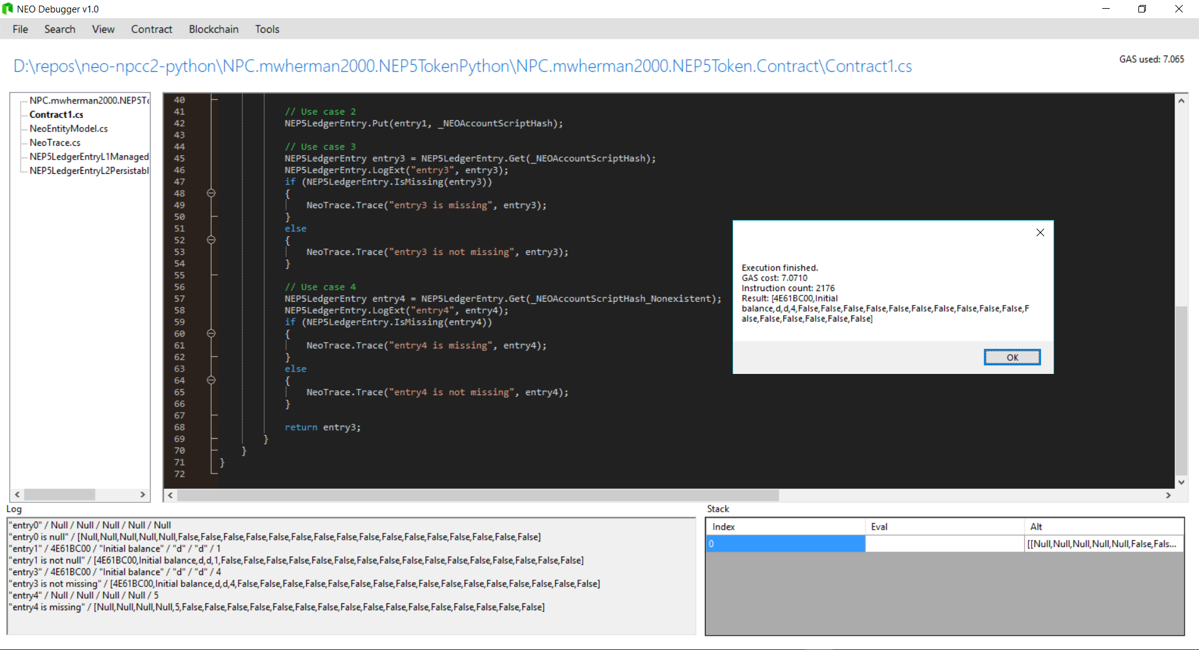
5 Initial Test Cases for Testing (needs NEO Debugger) https://github.com/mwherman2000/neo-npcc2-python/ blob/master/NPC.mwherman2000.NEP5TokenPython/ NPC.mwherman2000.NEP5Token.Contract/Contract1.cs

Slide 9
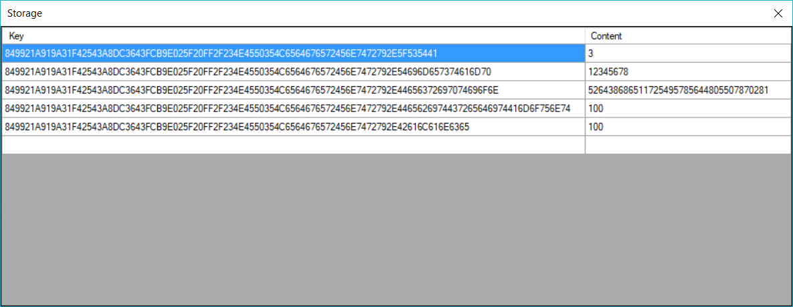
5 Initial Test Cases for Testing (F6 in New Debugger) https://github.com/mwherman2000/neo-npcc2-python/ blob/master/NPC.mwherman2000.NEP5TokenPython/ NPC.mwherman2000.NEP5Token.Contract/Contract1.cs

Slide 10
Questions?
Michael Herman (Toronto) – Independent Blockchain Developer
G: https://github.com/mwherman2000/neo-csharpcoe E: mailto:neotoronto@outlook.com L: https://www.linkedin.com/in/mwherman/ M: https://www.meetup.com/NEO-Blockchain-Toronto F: https://www.facebook.com/neotoronto/ T: https://www.twitter.com/neotoronto

